Slide 1

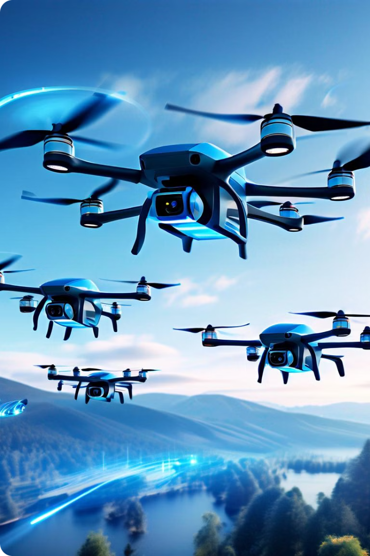
Enhancing YOLOV5 for Drone and UAV Detection
Ben-Gurion University - IEM Department
Dr. Ari Pakman
Introduction to Deep Learning
2024 Semester B Final Project - Group 10 15/7/2024
By Alon Bar Koter, Noa Gerson, Shahar Shpitaler, Andrei Plotkin

Slide 2
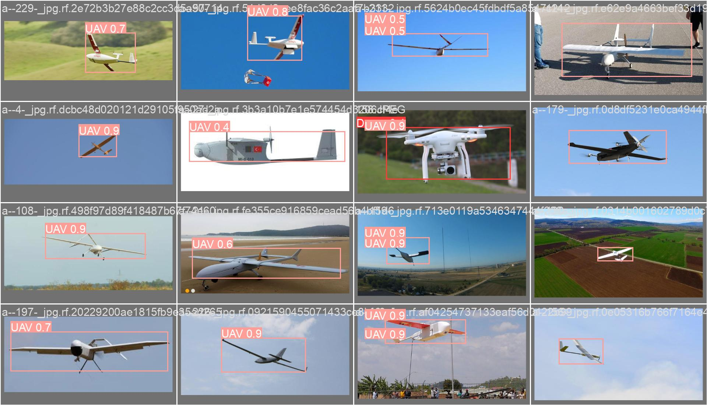
Motivation
Overall market share of 30.2B USD in 2024 (5.42M units)
Civil and commercial applications: delivery, security, agriculture
Photography and videography, mapping
Data transmission
Military operations
Challenges criminal activities

Slide 3
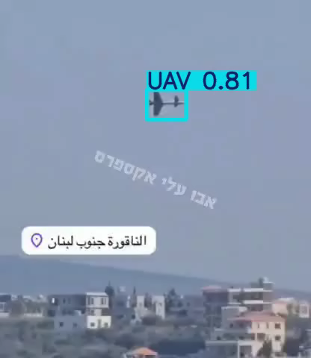
Motivation

Slide 4

Project Goals
1
Train a custom YOLOv5
Establish baseline for drone and UAV detection performance.
2
Enhance Architecture
Attempt to increase inference speed and accuracy by modifying
model architecture (C3tr/Ghost/ Focus).
3
Hyperparameter tunning
Translate, Shear, Mixup, Scale.
4
Future work –Pruning
Reduce computational costs while maintaining accuracy.
Notes:
Architecture parameters:
Base training model 1766751 parameters. C3tr to 900K
C3tr- transformer module
Focus- diff convolution
Ghost- adding nodule
Baseline (with and w\o hp)
C3: + - HP:
Ghost: +- HP
Focus +- HP

Slide 5





Data Preparation
Download dataset
Preprocess images
Annotate images
Validate data
Obtain 4.5k images multipole sources
Clean and format data for training
Ensure proper labeling for accurate detection
Verify dataset quality and consistency

Slide 6
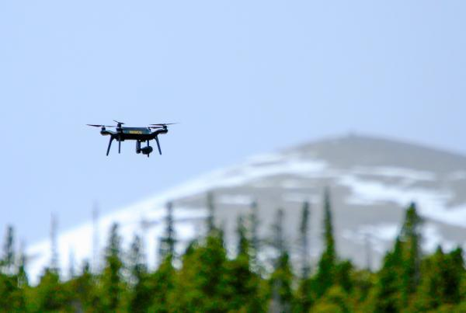
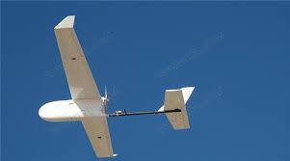
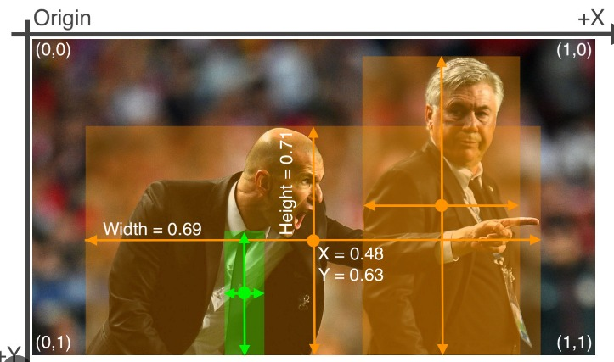

`
Dataset
Drones
UAV’S
3155 450
Train
788 112
Test
Notes:
Different size images of drones and uavs from the internet, with different image size and distances

Slide 7
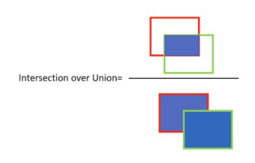
Yolo (You Only Look Once)
What is Yolo?
A real-time object detection system.
How it works:
Residual blocks- divide the image into N*N grid. Each is responsible for localizing and predicting the class it covers.
Bounding box regression
Intersection Over Unions or IOU for short
Non-Maximum Suppression. keep only the boxes with the highest probability score of detection.
Our target measurements
MAP50, 50-95 (Mean Average Precision)
Speed- GFLOPS – Giga Floating Point Operations Per Seconds
Model Size/ Complexity (# parameters)
Notes:
Different size images of drones and uavs from the internet, with different image size and distances

Slide 8

YOLOv5 enhancement's
C3TR (Transformer Enhanced C3)
A variation of the C3 layer that integrates transformer-based mechanisms for capturing
long-range dependencies and enhancing feature extraction.
GhostConv
An efficient version of the convolutional layer that reduces the number of parameters
and computational cost by generating more feature maps with fewer computations.
C3Ghost
Combines the C3 layer with Ghost Convolutions to reduce computational
complexity while maintaining efficient feature extraction.
Focus
A layer that slices the input feature map into smaller patches and concatenates them
along the channel dimension. This helps in capturing fine-grained details.

Slide 9
Optimize Hyperparameters
Shear
Introduces geometric deformations by tilting the images along the x or y-axis.
Mimics real-world situations where objects may appear tilted due to camera angles.
Scaling
Resizing the input to different scales or dimensions. Enable to handle both small and large objects effectively.
Mixup
Combine pairs of images and their corresponding object labels to create new training examples. Enhances the model’s ability to handle variations in object appearances.
Translation
Involves shifting or moving the objects within the image. Improves accuracy in detecting objects even when they are not centered or located at expected positions.

Slide 10
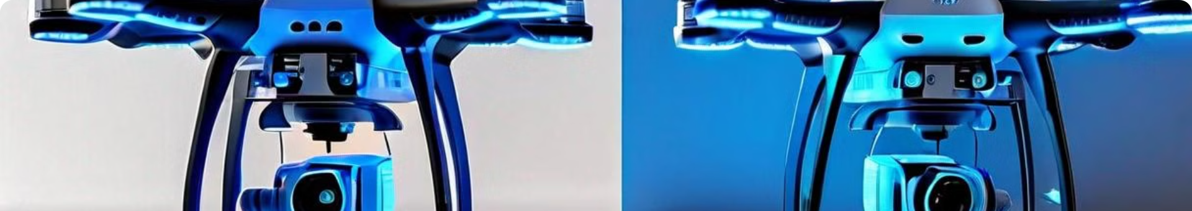
Model comparison and conclusion

